Slide 1
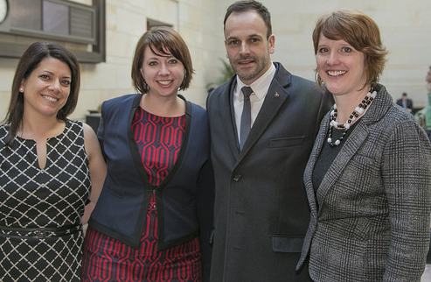
Advancing Rare Disease Treatments in the Era of Cures and Health Care Reform 2017
Thank you for having me here today. Sorry I did not bring Jonny Lee Miller with me this year.

Slide 2
“I picked my husband, Jeremy up at a dive bar in Hells Kitchen” - Jill Wood
At the time:
Jeremy worked in film and I worked in fashion.
We fell in love and moved into a tiny apartment in the L.E.S. NY. Life was perfect.
Our Love Story…

Slide 3
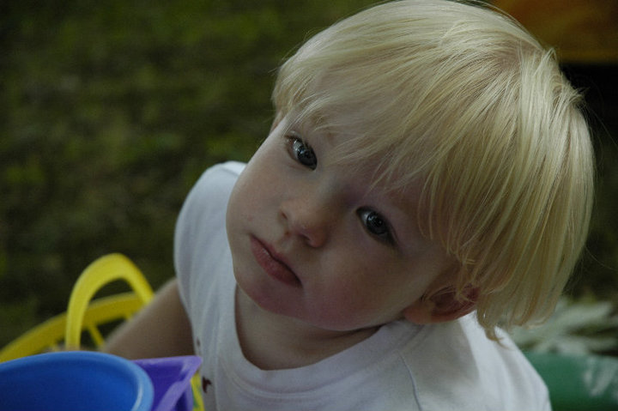
Our only child Jonah was born in 2008
My pregnancy and labor was uncomplicated. Jonah was perfect in every way. We had NO idea that we had both passed down our genetic mutations to Jonah.
Each one of us carries several mutations that you can pass to your child.
All you young staffers in the back that are thinking about planning your families LISTEN UP! This could be your story too.
l

Slide 4
Ground Zero a.k.a. Diagnosis Day
Our doctor suggested an MRI based on Jonah’s head circumference. Jonah was dx’d with MPSIIIC at 22mo.
Jonah is the youngest known child to have been diagnosed A-symptomatic without an older brother or sister being dx’d first.
On average MPSIIIC children are not dx’d until 6 years of age.
We need New Born Screening.
We were ‘lucky’ Jonah was diagnosed before disease onset; giving us the chance to save his hearing and receive early intervention services that gave him the chance to speak at age level. To fight his fate!
Sanfilippo is terminal and there is no treatment.

Slide 5
Sanfilippo Syndrome facts…
Sanfilippo is one of the 6 forms of Mucopolysaccharidosis (MPS)
Sanfilippo breaks down into 4 Subtypes: A,B,C,D
MPSIIIC and D are ‘said’ to occur in 1 in 1.5 Million births. We’re an ‘uber’ rare disease
20 MPSIIIC and 2 MPS IIID are known of in the US
Our children are missing an enzyme that breaks down a complex sugar chain, Hepran Sulfate.
Hepran Sulfate is left to store up in every cell of the body. Causing catastrophic effects; in most cases leading to death before the 2nd decade of life.

Slide 6
We hit the ground running…
Created Jonah’s Just Begun-Foundation to Cure Sanfilippo Inc.
Identified Patient Population
Held Patient Population Meeting in 2010
Identified Research
Started Funding Research
Created MPS Patient Registry

Slide 7
JJB is not alone! We fight our childrens fate together.

Slide 8
Still not enough… Co-Founded virtual biotech

Slide 9
NIH has yet been given their budget for this round of STTR funding
Small Business Technology Transfer
Grass roots funding only goes so far
Need millions to get to clinical trial
Co-Founded virtual biotech, Phoenix Nest
We have won 3 NIH STTR grants ( ~2M)
1 pending STTR ($225k)
1 pending RO1
Licensing IP
LABiomed MPSIII D and B

Slide 10
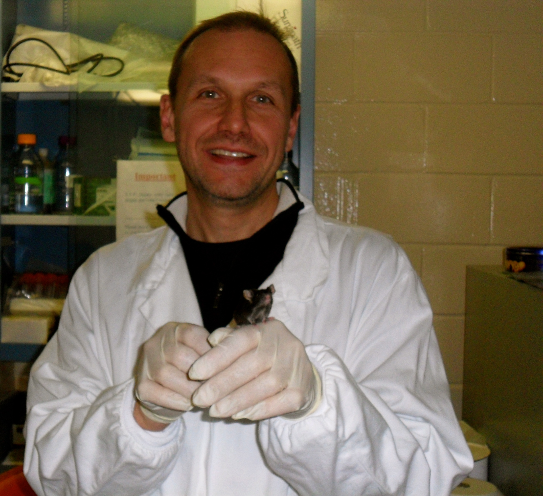
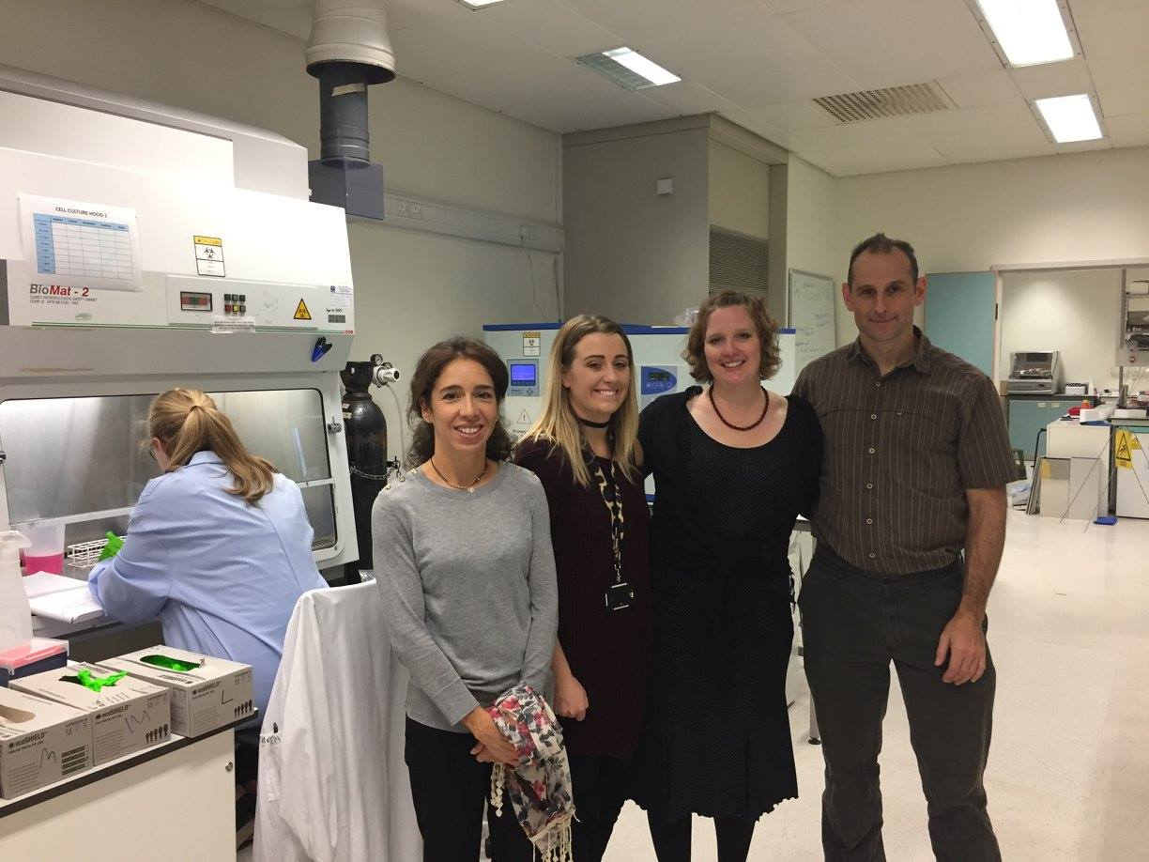
STTR grants don’t fund outside of U.S.
Licensing these programs
Alexey Pshezhetsky, Montreal Canada
Brian Bigger and Claire O’Leary, Manchester, U.K.

Slide 11
They are the only known children with MPSIII D in the U.S. We are hopeful that the Pediatric Priority Reviewer Voucher (CURES Act) will sustain the development and commercialization of their treatment.
Only known MPS III D patients in the U.S.
1R41NS089061-01 $223,102
1R41NS089061-02 $1,495,000.00

Slide 12
Please hear us…The Science is here now! We can’t loose momentum.
Please support the Open Act- Repurpose drugs
Newborn Screening, saves lives.
Increase NIH & FDA funding.
Affordable Care Act
Preexisting conditions

